Slide 1

MINT – Forth’s Kid Brother?
Forth 2020 Saturday 10th May 2025 Ken Boak

Slide 2
Introduction to MINT, how it evolved, similarities and differences to Forth.
Early work: MUSYS (1969), MOUSE (1979) both by Peter Drogono , Tiny Forth (T. Nakagawa 2004), Txtzyme (Ward Cunningham 2011), SIMPL (Ken Boak 2013) and STABLE (Sandor Schneider 2016).
The first real MINT - a Z80 assembly language implementation (for the TEC-1 and RC2014), by John Hardy, Craig Jones and myself in 2021.
Other versions: MINT6502 (Alvaro Barcellos), CMINT (Jason C.J. Tay).
New developments:- eMINT (inspired by C.H.Ting's eForth model).
Future Work and Applications.
Demo and questions.

Slide 3


Slide 4

Introduction to MINT
MINT comes from the portmanteau of Minimal INTerpreter.
It is an interpreted, stack-based, integer arithmetic, RPN language.
Like Forth, it uses both a data stack and a return stack.
It uses printable ascii characters as words, variables and primitives.
Many of the symbols and syntax used will be familiar to Forth Users.
There is no dictionary, words are single characters accessed via a jump table.
It provides a subset of Forth - intended for lightweight, resource limited implementation.
The source code is very compact, with good degree of human readability.
Source code text can be cut and pasted with text editor and serial terminal.
MINT is ideal for r microcontrollers and microprocessors lacking in ROM and RAM.
The MINT interpreter occupies typically less than 2k bytes (on Z80).

Slide 5
The Evolution of MINT – a little history:- Part 1.
It started with TinyForth by T. Nakagawa in 2004, a cut down Forth, similar in philosophy to TinyBASIC, 26 variables and a reduced word set.
In 2011, Ward Cunningham wrote Txtzyme a tiny interpreter to run on Arduino.
It had just 13 commands, one variable x, no arithmetic, no stacks, no : ; defs.
It provided an immediate, interpreted environment to interact with the I/O.
I came across Txtzyme in 2013, creating SIMPL on Arduino and MSP430.
SIMPL - Serial Interpreted Minimal Programming Language.
This added maths, User Defined functions (colon defs) and more variables.
I used it for exercising motion control systems and force sensor instruments.
I also wrote a simple memory dump screen/editor for MSP430 using SPI RAM.
I called SIMPL a ”hardware bring-up tool” for initial testing of new hardware.

Slide 6

The Evolution of MINT – a little history:- Part 2.
SIMPL was ported to STM32 MCU and other Arduino compatible dev-boards.
Still lacking stacks, it could perform loops, sequences and conditional code.
User (colon) definitions could be chained together to form new functions.
I ported it to MSP430 assembly language, having read of Ting’s eForth model.
SIMPL development was paused due to other work commitments.
In 2019, I began thinking about using SIMPL as “assembly language” for a VM.
I needed to find a simple solution to implementing the missing stacks.
I had watched John Hardy’s presentations on Forth for Z80.
This encouraged me to write SIMPL in Z80 assembly language for my RC2014

Slide 7

The Evolution of MINT – a little history:- Part 3.
In lockdown of Spring 2021, I heard about the STABLE language by Sandor Schneider.
STABLE is a minimal interpreted bytecode language, written in 50 lines of compact C.
Most importantly, this gave me formal implementations for the stacks, in C.
At the same time, John, Sandor and I founded “Minimalist Computing” on Facebook.
John and I discussed an implementation of such an interpreter on the Z80.
John saw MINT as an alternative to assembly language on the TEC-1 computer, a small Z80 machine developed by John in the early 80s for “Talking Electronics” magazine in Australia.
It used a hex-keypad and 7-segment LEDs, limited to just 2K ROM, and 2K RAM.
I worked on the inner interpreter and arithmetic routines, John handled the stack handling and arrays, and Craig Jones provided the new bit-banging serial I/O code.
MINT for Z80 was first demonstrated at Christmas 2021 on both TEC1 and RC2014.

Slide 8
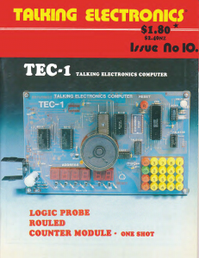

Slide 9
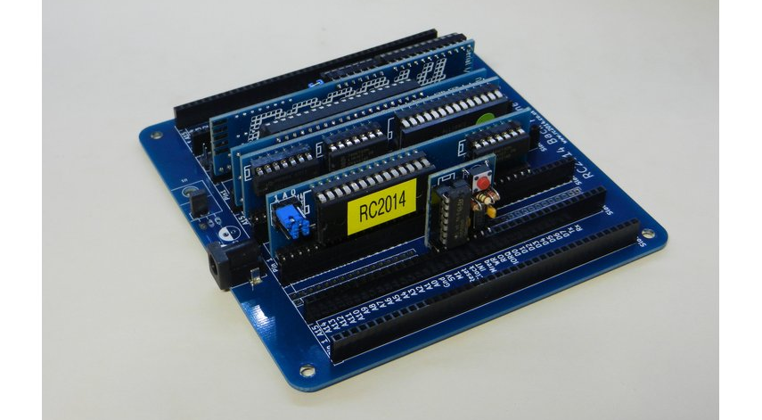

Slide 10
Implementing MINT
The MINT virtual machine can be readily implemented on almost any CPU.
There are 31 operations which can be accessed using an 8-bit jump table.
Support routines for character, string, decimal and hex number input and output via a serial UART are also needed.
16-bit variables are defined by lower case characters a – z.
User Routines (Colon Definitions) are defined by upper case A-Z characters and use the familiar : ; notation borrowed from Forth.
Memory access is via the familiar FETCH @ and STORE !
Special cases are used for Stack Pointer, Return Stack Pointer, TOS and R.
Arithmetic, logical and shift operations +, - , * , / , &, | , ^, ~, _, { and }
Hex numbers are preceded by #
Stack operations are DUP “, DROP ‘, SWAP $ and OVER %.
The \ character can precede any other character and provide an extended function accessed by an extension jump table.

Slide 11
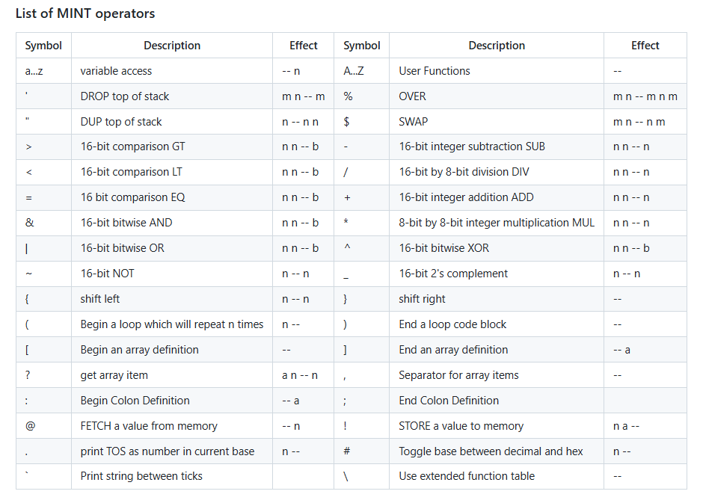

Slide 12
Other implementations: MINT6502 and CMINT
Having successfully proven the implementation in under 2Kbytes on the Z80, I wanted to show that it could be applied to other “classic” 8-bit CPUs.
A version MINT6502 has been written by Alvaro G S Barcellos in 6502 assembly.
I hope to port this to my 1980 Acorn Electron home computer, with simple text input and monochrome text display. My post-apocalypse, Collapse OS project.
A generic version, CMINT, has been written in C, by Jason C.J. Tay.
CMINT has been ported to a wide range of MCUs, including ATmega328, 8052, STM32F743. The next slide shows comparative benchmarks for CMINT (1 million empty loops) running on various MCUs.
The Z80 was a lot slower – even in assembly language - a million empty loops was 37.3s with a 7.3728MHz clock! 275 clocks per iteration.

Slide 13
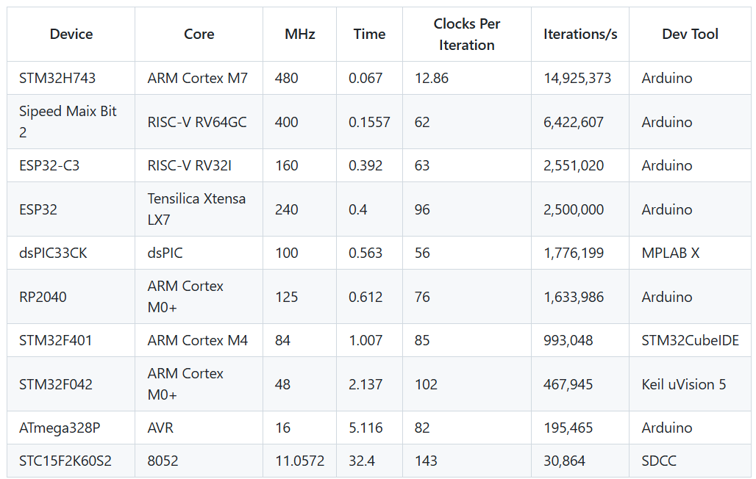
CMINT Benchmarks for 1,000,000 empty loops – Jason C.J. Tay.

Slide 14
New developments:- eMINT inspired by C.H.Ting’s eForth model.
Ting’s model reduces the Forth inner interpreter to just 31 primitive functions.
These primitives are equivalent to the instruction set of a virtual machine.
A full Forth can be built using these primitives, each written in minimal, target specific assembly language.
I noticed that Ting’s choice of primitives are very similar to those of MINT.
Using the eForth primitives to define MINT, we can use MINT to build a Forth.
But a MINT primitive is defined by 1 character, not a 16-bit jump address.
Thus, an eForth build could be implemented in fewer bytes.
John Hardy had already written some of the more advanced MINT functions using inline MINT code – thus proving the concept.
eMINT could be a compact means to provide portable code for a variety of CPUs
Conceptually, eMINT is eForth’s kid brother.

Slide 15
Applications and Future Work
MINT has acquired a small, dedicated following within the TEC-1 Community.
John Hardy has written an extended, Z80 version of the language, MINTX.
I am slowly working towards a CPU design in 74HCxx logic or FPGA that executes MINT as its native assembly language. – the “MINT Machine” Inspired by James Bowman’s J1 Forth CPU and C.H. Ting’s eForth.
MINT has a very limited symbol set. Using Python or C++, a cross assembler could be developed to automate the build of MINT for many MCUs.
Python scripts could be used to automate the assembly of MINT, converting a higher level language program to MINT primitives - a MINT scripting tool. Conversely it could be used to decompress/expand MINT to less terse words.

Slide 16
The MINT Machine
A 16-bit Virtual Machine that executes MINT as it’s native assembly code.
Based on James Bowman’s J1 Forth CPU with modified ISA, and the Ferranti F100-L , an early UK, 16-bit microprocessor from 1976.
MINT instructions based on C.H. Ting’s eForth primitives.
Simulated in about 100 lines of C++ using Arduino IDE, for accessibility.
Intended for implementation in 74xx logic or as a small soft core in FPGA.
Using bit-serial architecture, it could be implemented in as few as 1000 gates and used as a smart SPI controller and other serial applications .

Slide 17
Extending MINT
MINT reserves the \ character as a possible means to extend the language.
The basic MINT code avoids using this character, permitting it to be used as a tag to infer different meaning or syntax - a bit like Chuck Moore’s colorForth.
Using a \ tag would allow longer word names & the use of a dictionary search.
Extending words to 2 characters would allow over 9000 unique definitions.
The \ could be used to code the following ascii characters with bit 7 set.
This coding was often used to provide inverse video on monochrome displays.

Slide 18
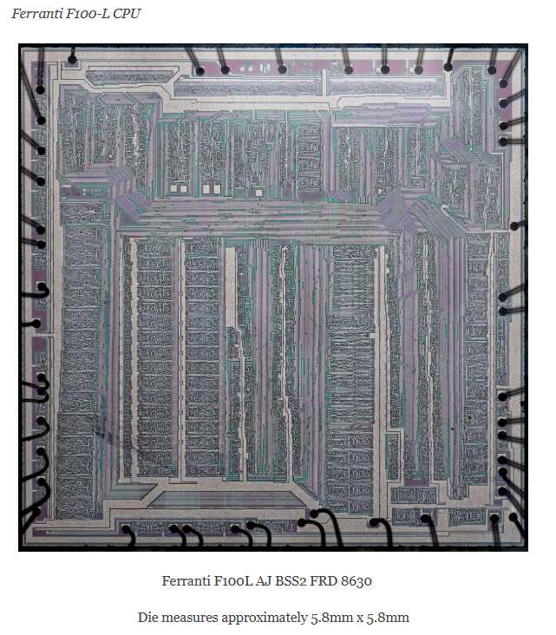

Slide 19
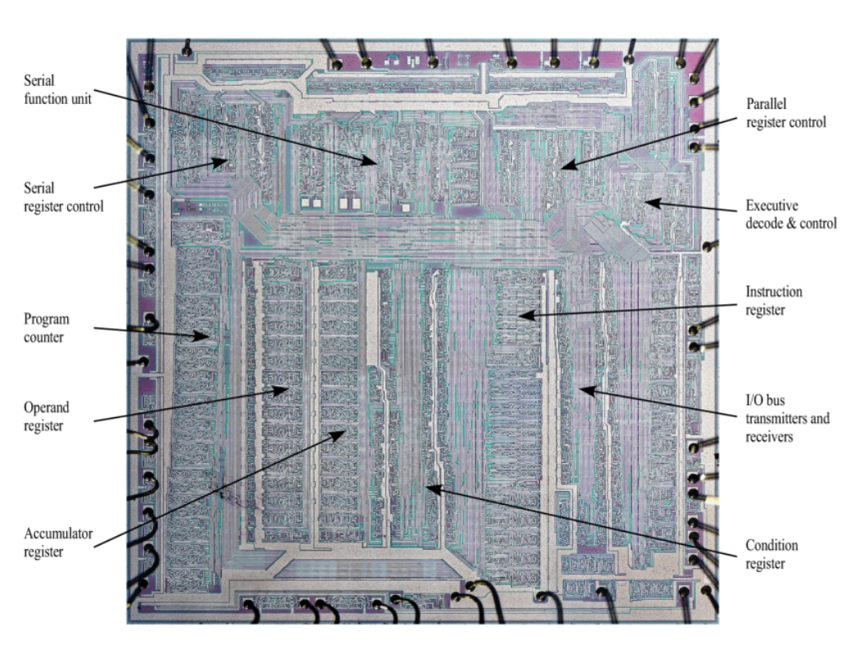

Slide 20
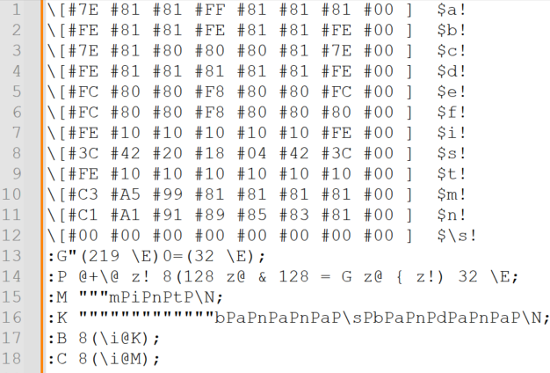
Demo and Questions
675 characters of MINT source code – as used in demo

Slide 21
Links and Resources
Tytzyme -Ward Cunningham https://github.com/WardCunningham/Txtzyme
TinyForth - T. Nakagawa http://middleriver.chagasi.com/electronics/tforth.html
SIMPL - https://github.com/monsonite/SIMPL
STABLE - https://w3group.de/stable.html
MINT (Z80) - https://github.com/orgMINT
MINT (6502) - https://github.com/agsb/6502.MINT
CMINT - https://github.com/trozodejamon/CMINT
MINT Computing - https://www.facebook.com/groups/278238447530031
Minimalist Computing https://www.facebook.com/groups/minimalistcomputing
eForth C.H. Ting - http://www.exemark.com/FORTH/eForthOverviewv5.pdf
Ferranti F100-L - https://revaldinho.github.io/f100l/

